Slide 1

School of Computing
Vel Tech Rangarajan Dr. Sagunthala R&D Institute of Science and Technology
Department of Computer Science and Engineering
10211CS224 / FULL STACK APPLICATION DEVELOPMENT (JAVA)
PROJECT REVIEW : MILESTONE PROJECT – 2
Date: 17-04-2026
Smart Campus Event Management System
SDG 4 – Quality Education
Presented By:
K.Likith kumar – VTU24742 – Reg.No: 23UECS1104
Courses Handling Faculty:
Dr.S. Hemamalini -Assistant Professor

Slide 2
INTRODUCTION
1
Academic institutions conduct many workshops, seminars, technical events, and cultural programs throughout the year.
In many cases, event announcements and registrations are handled manually or through scattered platforms.
This creates confusion for students and extra administrative work for coordinators.
A centralized portal is needed to display events, manage registrations, and maintain records efficiently.
This project provides a full-stack web application for campus event management.
It offers separate access for students and administrators.
Students can view and register for events easily.
Admins can create, manage, and monitor events through a secure dashboard.
2
3
4
5
6
7
8
9

Slide 3
PROBLEM STATEMENT
1
Existing campus event handling is often manual, fragmented, and time- consuming.
Students may miss event information or face difficulty during registration.
Administrators may struggle to maintain participant lists and event records accurately.
Manual methods can lead to duplicate entries, data inconsistency, and poor tracking of capacity.
There is no single system to manage users, events, and registrations together.
Hence, a secure and automated campus event registration portal is required.
The system should simplify event creation, registration, and monitoring.
It should improve efficiency, accuracy, and accessibility for both students and admins.
2
3
4
5
6
7
8
9

Slide 4
OBJECTIVE(S)
1
To design and develop a role-based web portal for campus event management and student registration.
To implement secure authentication and database-driven tracking of users, events, and registrations.
2
3
4
5
6
7
8
9

Slide 5
PROPOSED SYSTEM
1
The proposed system is a web-based campus event and registration portal.
It provides separate student and admin login modules.
Students can view available events and register for them online.
Admins can create new events and delete outdated events.
The system validates login credentials and controls access using roles.
It prevents duplicate registrations and checks participant capacity.
All data is stored in a MySQL database for consistency and reliability.
This system reduces manual work and improves overall event coordination.
2
3
4
5
6
7
8
9

Slide 6
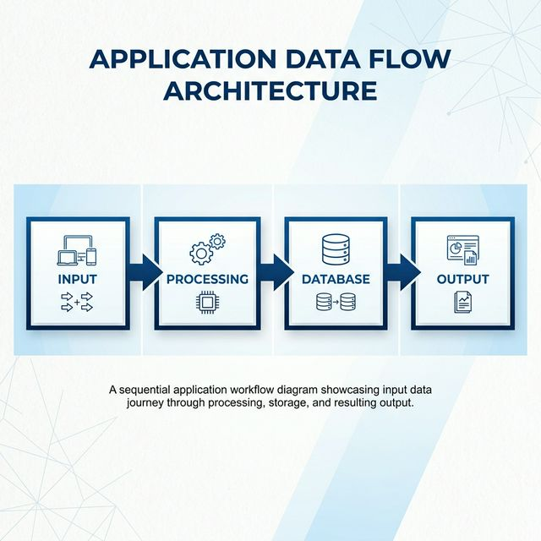
PROPOSED SYSTEM ARCHITECTURE
1
2
3
4
5 A
6
7
8
9

Slide 7
PROPOSED SYSTEM ARCHITECTURE
1
2
Use this matter below the diagram:
Input: Student and admin credentials, event details, registration requests.
Processing: Frontend sends requests to Express APIs, backend validates users, roles, and event rules.
Database: MySQL stores data in users, events, and registrations tables.
Output: Event listings, successful registrations, student dashboard, and admin management screens.
3
4
5 B
6
7
8
9

Slide 8
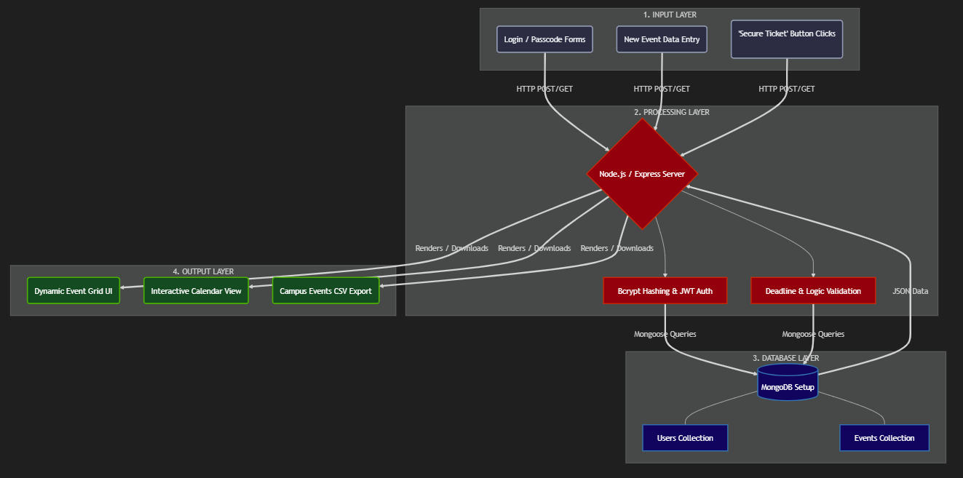
WORKFLOW
1
2
3
4
5
6 A
7
8
9

Slide 9
WORKFLOW
1
2
The user opens the Website.
Here he finds 2 logins (Admin and student) so here he can log in as a student or admin.
Students can browse events and register for them.
Admins can create events, view registrations, and delete events.
Each action is processed by the backend and stored in the database.
The updated result is then shown on the respective dashboard.
3
4
5
6 B
7
8
9

Slide 10
TECHNOLOGIES USED
1
Frontend: HTML5, CSS3, JavaScript
Backend: Java, Spring Boot 3.2.5, Spring MVC
Database: MySQL,Spring Data JPA
Security: Spring Security, Session-based Auth
Tools: Eclipse, Maven, Postman
Requirements: Browser, JDK 21, MySQL Server
2
3
4
5
6
7
8
9

Slide 11
MODULE DESCRIPTION
1
Module 1: Authentication and User Management
Handles student registration, student login, admin login, JWT token generation, and role-based access.
Module 2: Event Management
Allows admins to create, view, and delete campus events with title, description, date, location, and capacity.
Module 3: Registration Management
Allows students to register for events, prevents duplicate registration, and checks event capacity.
Module 4: Database and API Integration
Connects frontend pages with backend APIs and MySQL tables for storing and retrieving data.
2
3
4
5
6
7
8
9

Slide 12
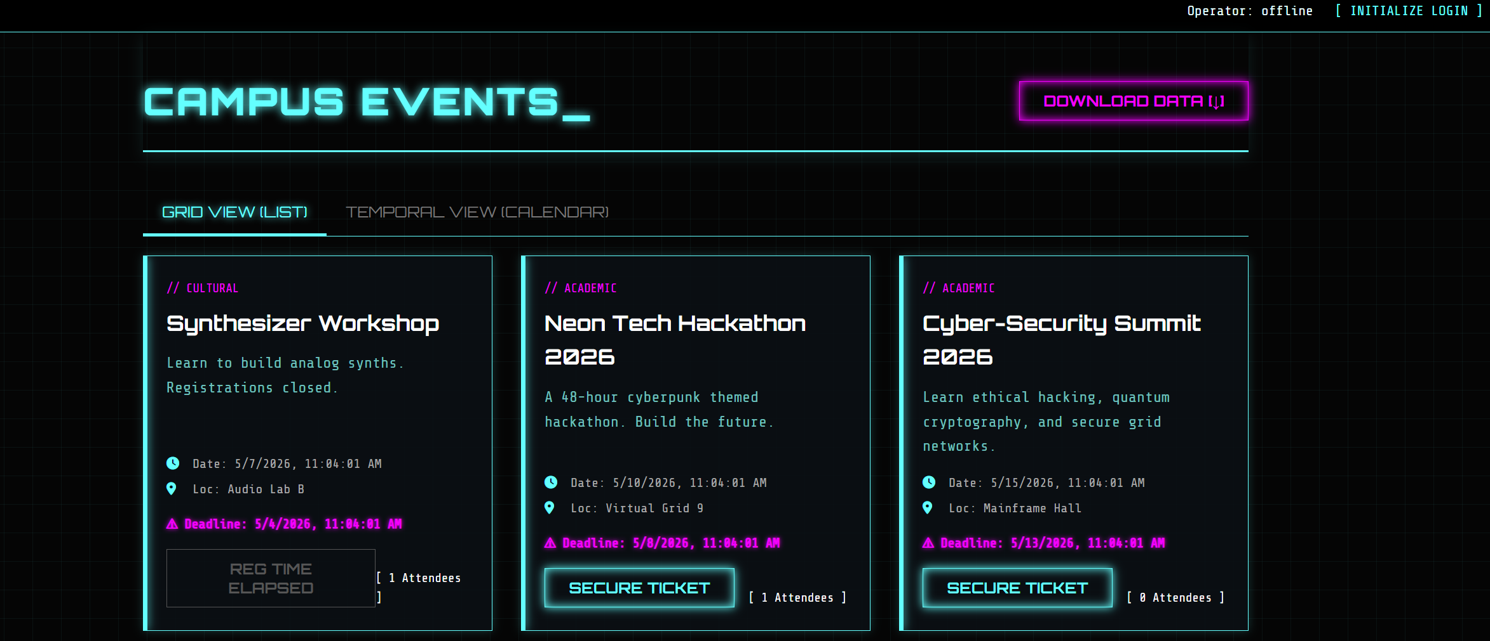
IMPLEMENTATION SCREENSHOTS
1
2
3
4
5
6
7
8 A
This is the landing page of the portal. It provides navigation for student login, registration, and admin login in a single interface.
9

Slide 13
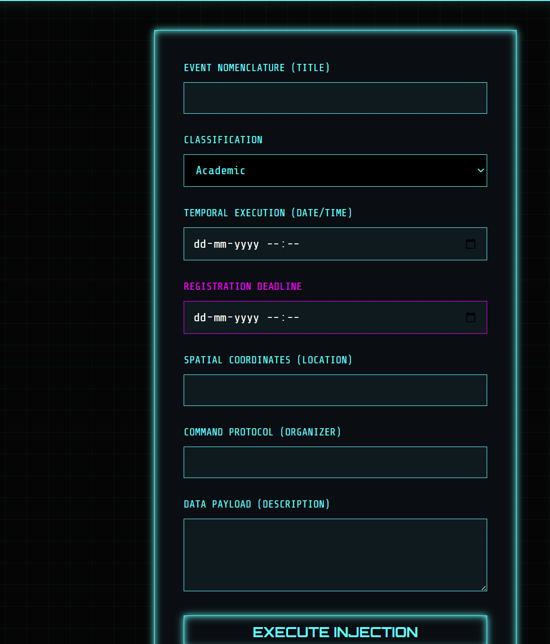
IMPLEMENTATION SCREENSHOTS
1
2
3
4
5
6
7
8 B
9
This screen allows new students to create an account and existing students to log in securely using their credentials.

Slide 14
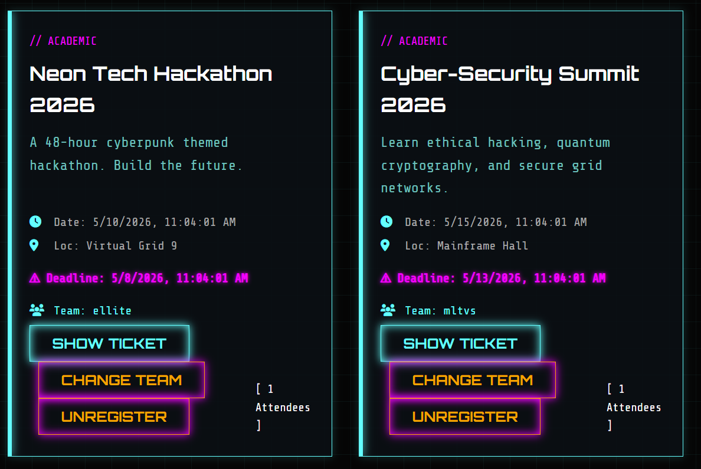
IMPLEMENTATION SCREENSHOTS
1
2
3
4
5
6
7
8 C
9
After login, students can view available campus events and register for them. The dashboard also shows their registered events.

Slide 15
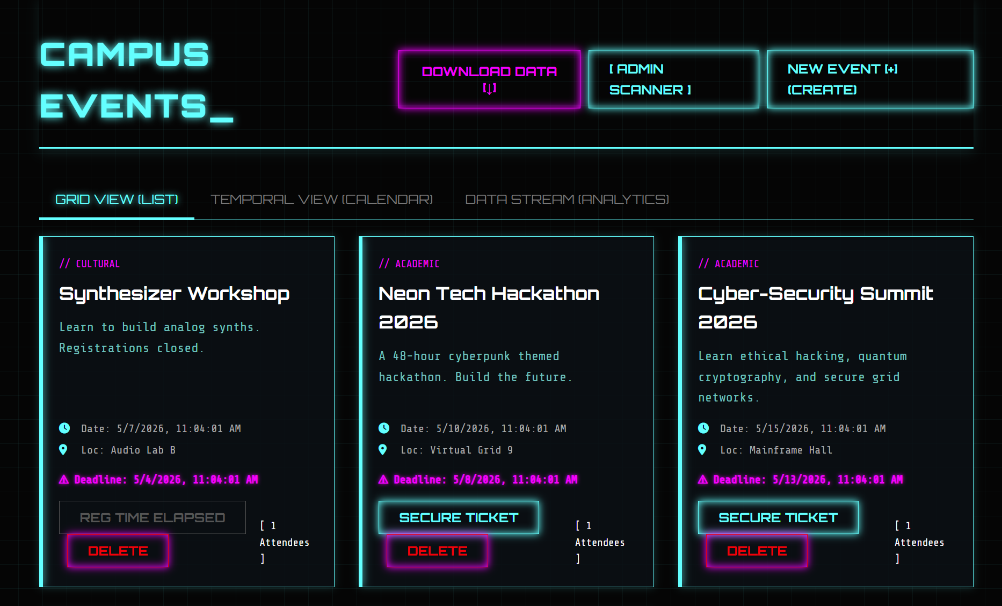
IMPLEMENTATION SCREENSHOTS
1
2
3
4
5
6
7
8 D
9
The admin dashboard is used to, delete events, and view the list of students registered for each event.

Slide 16
ADVANTAGES & LIMITATIONS
Advantages:
1
Centralized event management system
Easy student registration process
Role-based secure access
Prevents duplicate registrations
Database-backed storage improves accuracy
2
3
4
5
Limitations:
6
Depends on server and database availability
No email or notification feature
No event update/edit feature
Limited reporting and analytics
Admin setup must be managed properly
7
8
9

Slide 17
Thank you

